Slide 1
Unit1
Introduction to UNIX

Slide 2
What is UNIX?
Unix operating system is a set of programs that act as a link between the computer and the user.
The computer programs that allocate the system resources and coordinate all the details of the computer's internals is called the operating system or the kernel.
Users communicate with the kernel through a program known as the shell. The shell is a command line interpreter; it translates commands entered by the user and converts them into a language that is understood by the kernel.

Slide 3
Unix was originally developed in 1969 by a group of AT&T employees Ken Thompson, Dennis Ritchie, Douglas McIlroy, and Joe Ossanna at Bell Labs.
There are various Unix variants available in the market. Solaris Unix, AIX, HP Unix and BSD are a few examples. Linux is also a flavor of Unix which is freely available.
Several people can use a Unix computer at the same time; hence Unix is called a multiuser system.
A user can also run multiple programs at the same time; hence Unix is a multitasking environment.

Slide 4
What is UNIX?
Interacts with:
Applications
Users, through a command language interpreter
OS offers services:
Scheduling of multiple programs
Memory management
Access to hardware
Reports errors to applications

Slide 5
UNIX Features
Unix is an operating system, so it has all the features that the OS must-have. UNIX also looks at a few things in a different way than other OS. Features of UNIX are listed below :
1. Multiuser System :
Unix provides multiple programs to run and compete for the attention of the CPU. This happens in 2 ways :
Multiple users running multiple jobs
Single user running multiple jobs
In UNIX, resources are actually shared between all the users, so-called a multi-user system. For doing so, computer give a time slice (breaking unit of time into several segments ) to each user. So, at any instant of time, only one user is served but the switching is so fast that it gives an illusion that all the users are served simultaneously.
2. Multitask System :
A single user may run multiple tasks concurrently. Example : Editing a file, printing another on the printer & sending email to a person, and browsing the net too at the same time. The Kernel is designed to handle user’s multiple needs.
The important thing here is that only one job can be seen running in the foreground, the rest all seems to run in the background. Users can switch between them, terminate/suspend any of the jobs.

Slide 6
3. The Building-Block Approach :
The Unix developers thought about keeping small commands for every kind of work. So Unix has so many commands, each of which performs one simple job only. You can use 2 commands by using pipes (‘|’). Example : $ ls | wc Here, | (pipe) connects 2 commands to create a pipeline. This command counts the number of files in the directory. These types of connected commands that can filter/manipulate data in other ways are called filters.
4. The UNIX Toolkit :
Unix has a kernel but the kernel alone can’t do much that could help the user. So, we need to use the host of applications that usually come along with the UNIX systems. The applications are quite diversified. General-purpose tools, text manipulation utilities (called filters), compilers and interpreters, networked programs, and system administration tools are all included. With every UNIX release, new tools are being added and the older ones are modified/ removed.

Slide 7
5. Pattern Matching :
Unix provides very sophisticated pattern matching features. The meta-char ‘*’ is a special character used by the system to match a number of file names. There are several other meta-char in UNIX. The matching is not confined to only filename. Advanced tools use a regular expression that is framed with the characters from this set.
6. Programming Facility :
Unix provides shell which is also a programming language designed for programmers, not for casual end-users. It has all the control structures, loops, and variables required for programming purposes. These features are used to design the shell scripts ( programs that can invoke the UNIX commands).
Many functions of the system can be controlled and managed by these shell scripts.
Shell Scripting

Slide 8
7. Documentation :
It has a ‘man’ command that stands for the manual, which is the most important reference for any commands and their configuration files. Apart from the online documentation, there is a vast amount of resources available on the Internet. If you’re stuck with a problem, there are various UNIX newsgroups where you can post your concerns. You can also go through the FAQ(Frequently Asked Questions) – a document that addresses several problems is widely used & available on the Net.

Slide 9
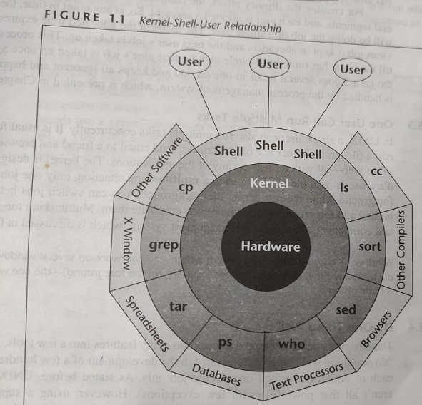
Unix Architecture:

Slide 10
kernel, shell, command and utilities,last file directories
The main concept that unites all the versions of Unix is the following four basics −
Kernel − The kernel is the heart of the operating system. It interacts with the hardware and most of the tasks like memory management, task scheduling and file management.
Shell − The shell is the utility that processes your requests. When you type in a command at your terminal, the shell interprets the command and calls the program that you want. The shell uses standard syntax for all commands. C Shell, Bourne Shell and Korn Shell are the most famous shells which are available with most of the Unix variants.
Commands and Utilities − There are various commands and utilities which you can make use of in your day to day activities. cp, mv, cat and grep, etc. are few examples of commands and utilities. There are over 250 standard commands plus numerous others provided through 3rd party software. All the commands come along with various options.

Slide 11
continued…
Files and Directories − All the data of Unix is organized into files. All files are then organized into directories. These directories are further organized into a tree-like structure called the file system.
Data structures like tree and hash

Slide 12
Command structure
Structure of unix command
$commandname options arguments
Here command name is mandatory, options and arguments are optional. They are used based on user requirement.
Example : ls -> this command lits files. only command name is used.
ls –l -> this command lists files along with permissions of files. option used here is –l.
ls –l note1 note2 -> this command lists files note1 and note2 along with permissions of files. Other options in ls command are
-t -> sorts files based on time of modification
-a-> includes hidden files.
We can combine options as follows.
ls –lat
cp command :
This command is used to copy content of one file into another when source and destination are files otherwise it copies files to directory.
Syntax: cp source destination
Example : cp file1.txt file2.txt -> copies content of file1.txt to file2.txt
cp file1.txt file2.txt progs -> copies files file1.txt and file2.txt into progs.

Slide 13
Internal & External commands :
Types of commands
1. internal commands 2. external commands
1. internal commands : these are shell built in commands. The code of these commands is part of shell. They are loaded and executed by OS.
Examples :
type -> indicates type of command,
type echo
o/p: echo is shell built.
pwd,cd,date,ls.
2. external commands : these commands are not built into shell. They have independence existence in /bin directory. When you type a command it look into PATH directory to locate it and execute it.
Examples: ls, cp, mkdir, rmdir, cat etc.

